Slide 1

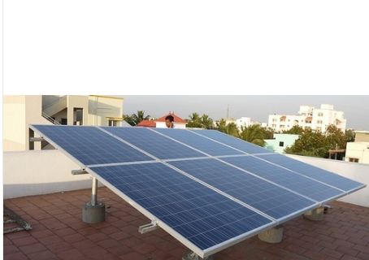
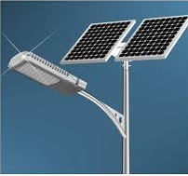
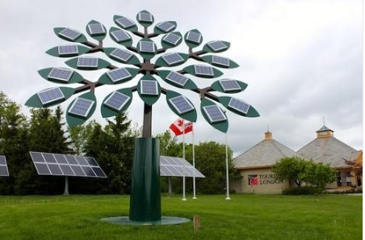
Unit 2 Solar PV Systems

Slide 2
Topics to be covered in this unit:
Solar PV Systems:
Solar cell fundamentals,
characteristics,
classification,
construction of module, panel and array,
stand-alone and grid connected;
Applications –Street lighting, domestic lighting and solar water pumping systems.

Slide 3
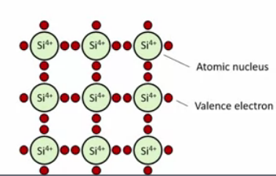
Solar cell fundamentals:
Solar cell is a device which converts solar energy into electrical energy.
Silicon is the most widely used material to manufacture solar cell.
Si has 4 valence electrons
Silicon itself is not sufficient to create solar cell

Slide 4
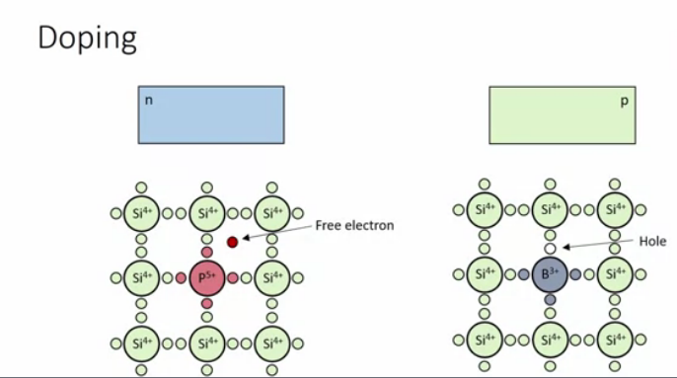
Doping helps to create excess electrons and holes in the system.
N-type has excess of electrons
P-type has excess of holes

Slide 5

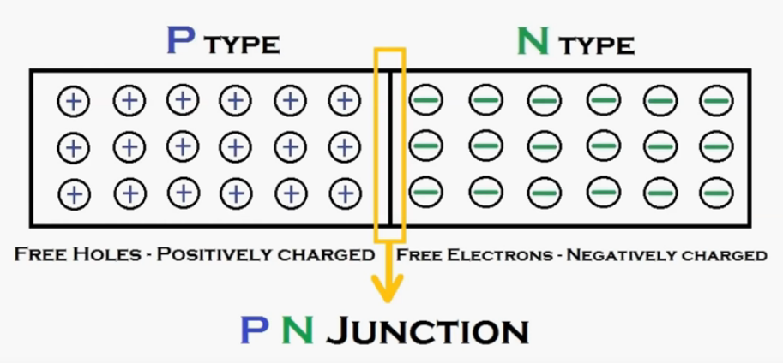

Slide 6
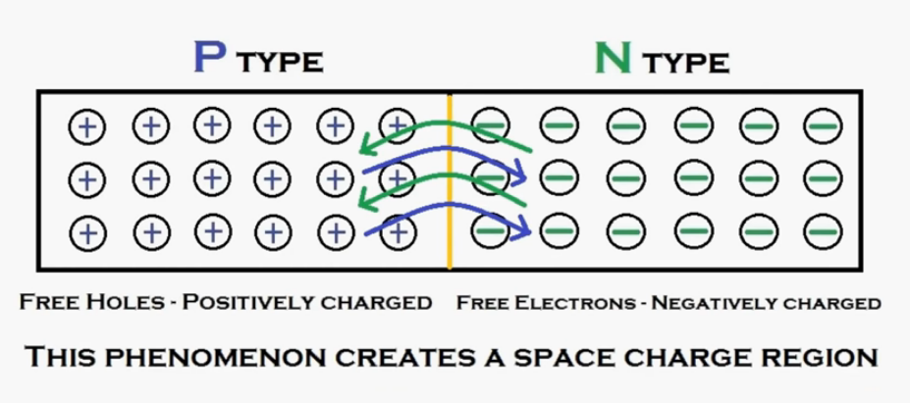

Slide 7
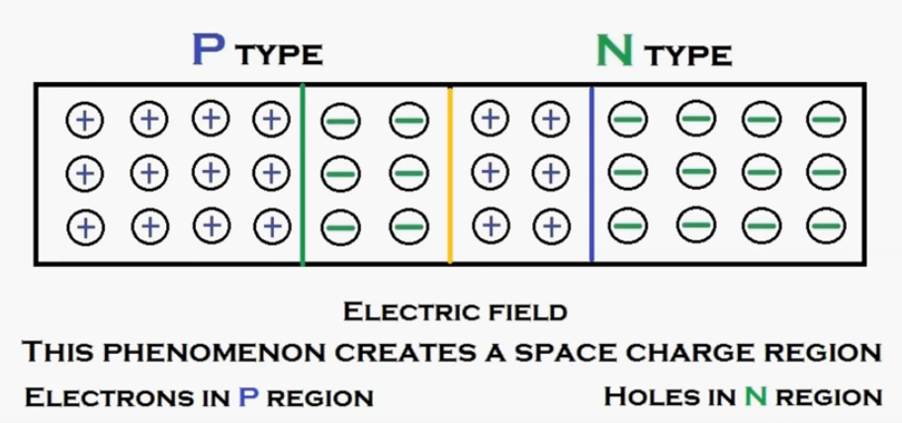

Slide 8
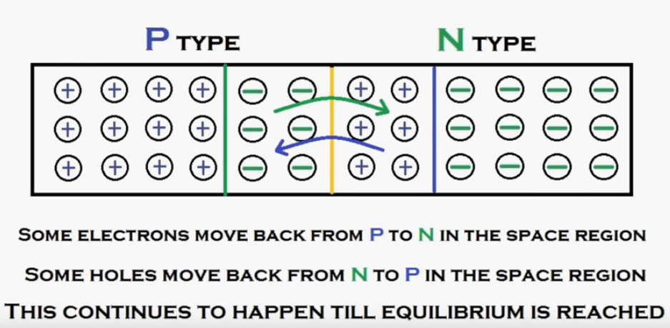
The electric field created in the space charge region will not allow the electrons and holes to jump into the other layer.

Slide 9
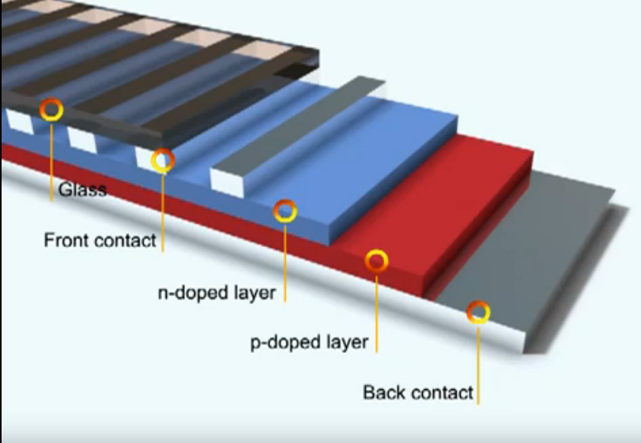
Solar cell layers:

Slide 10
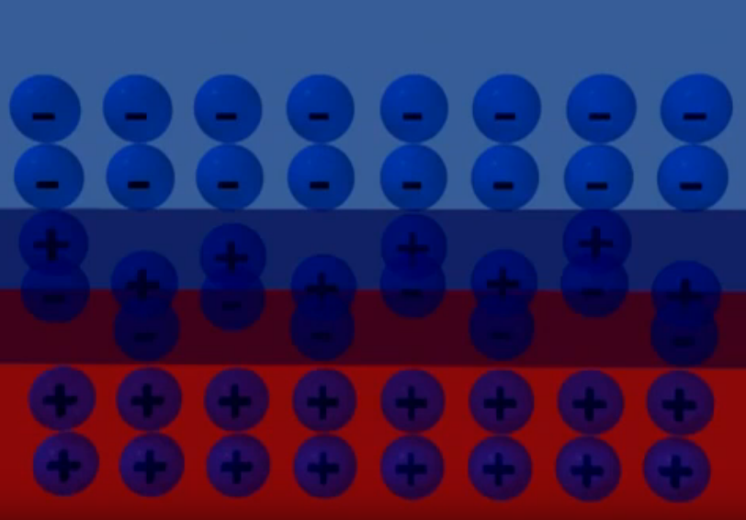

Slide 11
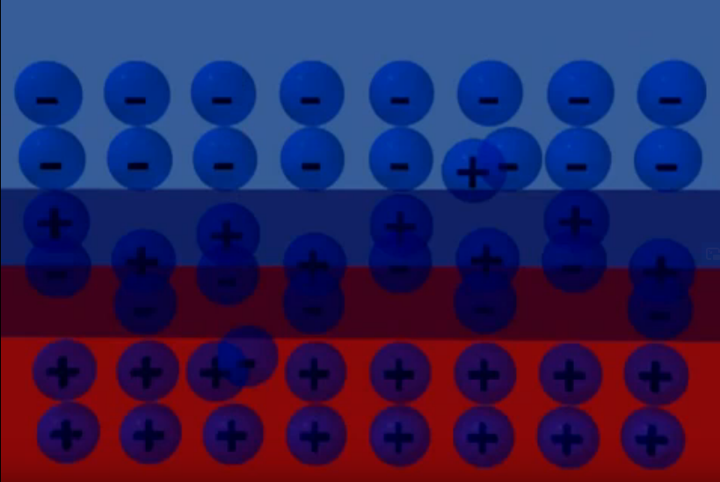
When sunlight (Photon) hits the cell:
When a photon of light is absorbed by one of these atoms it gets dislodge creating a free electron and a hole. The free electron and hole has sufficient energy to jump out of the depletion zone.

Slide 12
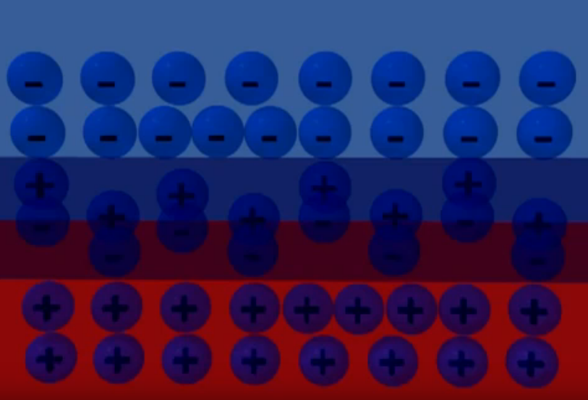
This creates an imbalance resulting in excess of electrons in N region and corresponding Holes in P region. These electrons will try to recombine with the holes in the P region.

Slide 13
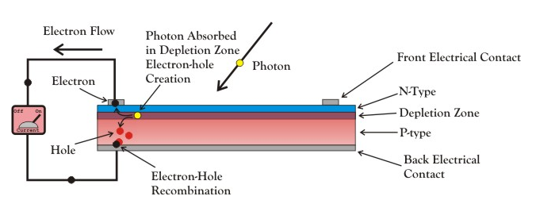
If there is an external circuit, then these excess electrons will that that path as shown in the above diagram
This flow of electrons results into a DC current which can be used further.

Slide 14
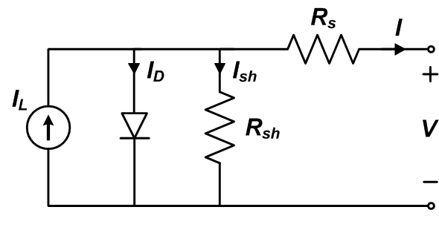
Characteristics of Solar Cell:
Electric Equivalent of solar cell:
An ideal solar cell may be modeled by a current source in parallel with a diode; in practice no solar cell is ideal, so a shunt resistance and a series resistance component are added to the model.

Slide 15
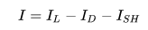
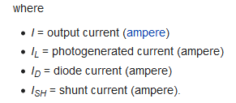
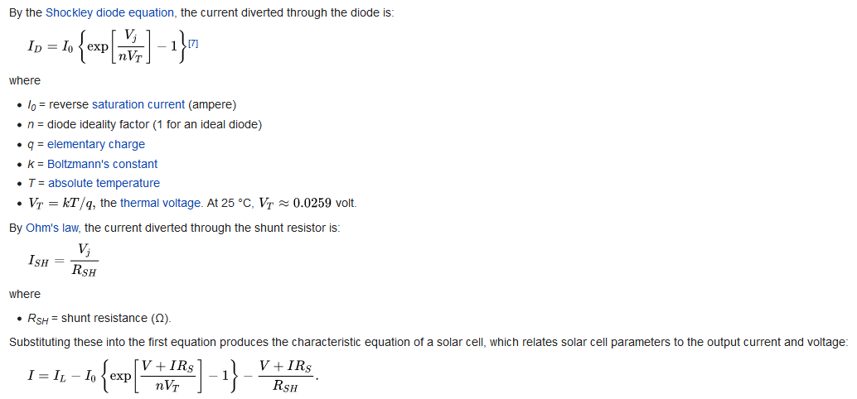
From the circuit, the current produced by the solar cell is given by,

Slide 16
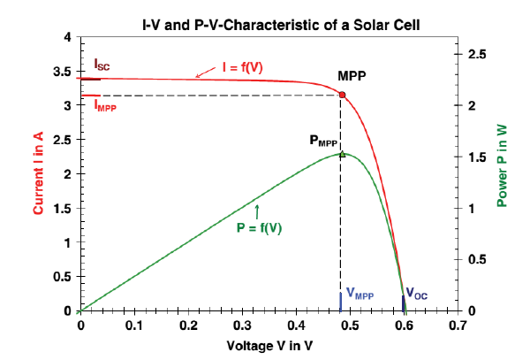
At short circuit condition (Fault, i.e. + & - terminal coming in contact), I is maximum and V is Zero
At Open circuit condition (When No load is connected across the + & - terminals), V is maximum and I is Zero

Slide 17
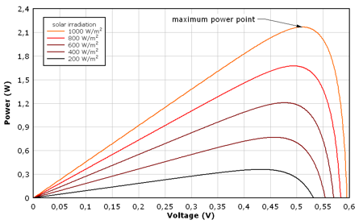
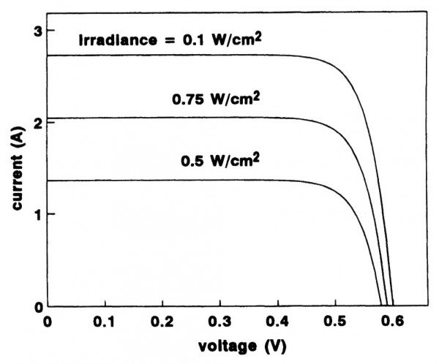
Variation of output power w.r.t change in irradiation:
Change in the Irradiation majorly affects the output current of the panel.

Slide 18
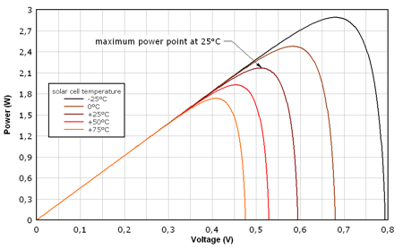
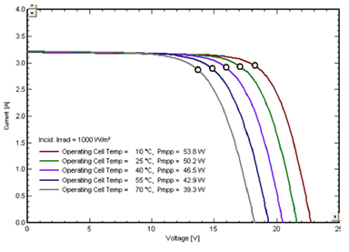
Variation of output power w.r.t change in Temperature:
Change in the temperature majorly affects the output voltage of the panel.

Slide 19
Maximum output is obtained at STC (standard test condition), i.e.
Temperature = 25 degrees celsius and
Irradiation = 1000 W/m2
(100 W solar panel can generate, 100 W only at STC)

Slide 20
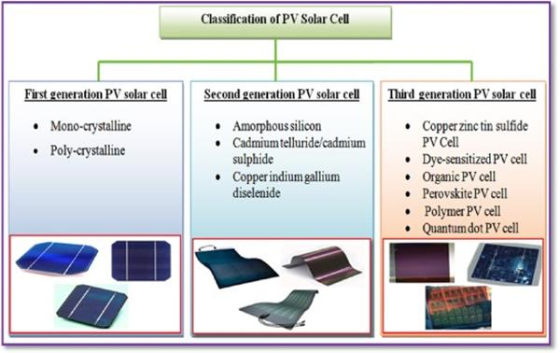
Classification of Solar Cells:

Slide 21
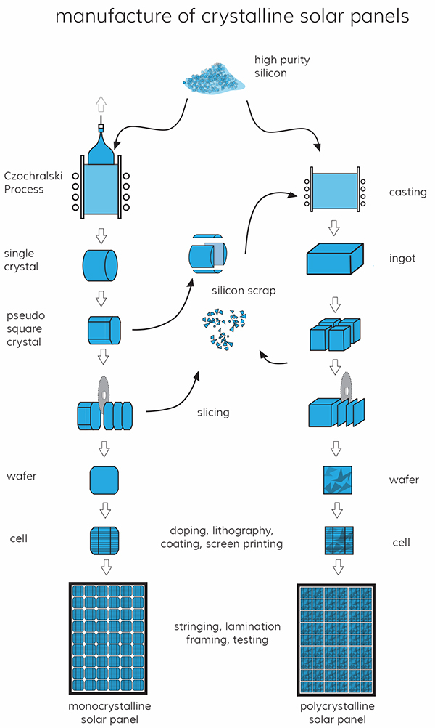
First Generation Solar Panels:
Monocrystalline Solar Panels
Polycrystalline Solar Panels

Slide 22
1. Monocrystalline Solar Panels
The first commercially available solar cells were made from monocrystalline silicon.
Made from extremely pure form of silicon.
To produce these, a seed crystal is pulled out of a mass of molten silicon by the process called czochralski process, creating a cylindrical ingot with a single, continuous, crystal lattice structure.
The Mono panels are manufactured using a single continuous crystal structure having very few impurities in the cell thus making them very efficient. (20% efficiency)
They use much less roof space to generate an amount of power equivalent to polycrystalline solar cells.

Slide 23
2. Polycrystalline Solar cells
In the manufacturing process of polycrystalline cells, molten silicon in a rectangular vat is allowed to cool down.
This cooling down process gives the panel its squared edges but instead of a single silicon crystal in the vat there are multiple crystal grains within the polycrystalline solar cells.
Efficiency of these cells is around 11 to 16%

Slide 24
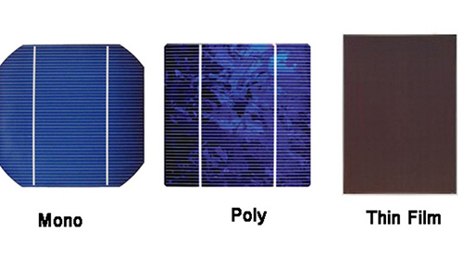

Slide 25
Second Generation solar cell:
The manufacturing process of these types of solar panels is relatively easier and involves depositing one or multiple films of photovoltaic Amorphous Silicon materials onto the back support sheet known as substrate
low in cost and lightweight.
These cells are flexible which makes it possible to use these cells in multiple applications
These panels have an efficiency rate as low as 7-9 percent only.
Thin film solar cells are less affected by high temperatures.
Require a lot of space

Slide 26
Unlike monocrystalline and polycrystalline solar panels, thin-film panels are made from a variety of materials. The most prevalent type of thin-film solar panel is made from cadmium telluride (CdTe). To make this type of thin-film panel, manufacturers place a layer of CdTe between transparent conducting layers that help capture sunlight. This type of thin-film technology also has a glass layer on the top for protection.
Thin-film solar panels can also be made from amorphous silicon (a-Si), which is similar to the composition of monocrystalline and polycrystalline panels. Though these thin-film panels use silicon in their composition, they are not made up of solid silicon wafers. Rather, they’re composed of non-crystalline silicon placed on top of glass, plastic, or metal.
Lastly, Copper Indium Gallium Selenide (CIGS) panels are another popular type of thin-film technology. CIGS panels have all four elements placed between two conductive layers (i.e. glass, plastic, aluminum, or steel), and electrodes are placed on the front and the back of the material to capture electrical currents.

Slide 27
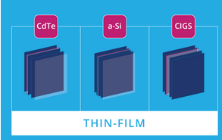

Slide 28
Third Generation Solar Panels
The third generation types of solar panels employ thin film technologies that are currently undergoing research and development to make them perfect for the growing solar market.
Some of these new age solar panels make use of organic materials while some use inorganic substances like organic photovoltaics (OPVs), copper zinc tin sulphide (CZTS), perovskite solar cells, dye-sensitized solar cells (DSSCs), and quantum dot solar cells
They have efficiency of around 30%

Slide 29
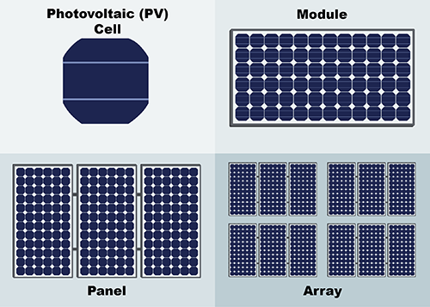
Construction of module, panel and array

Slide 30
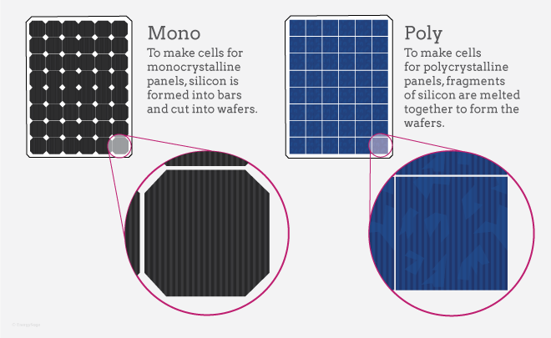
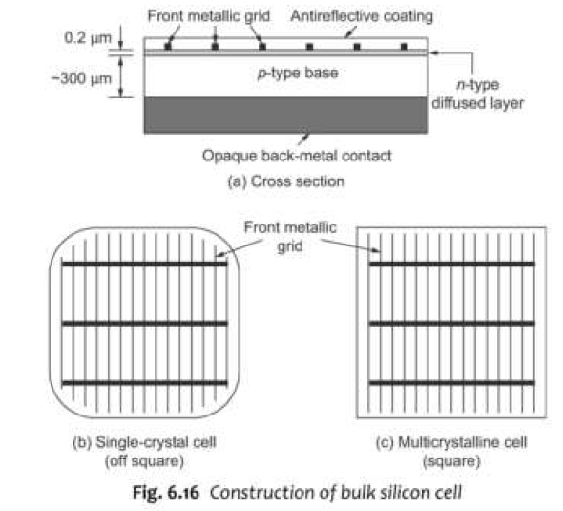
Solar PV Module:
Single solar cell output is very low.
Needs a series parallel combination to extract a workable amount of voltage power.
Interconnection of multiple cells to extract workable amount of power which are mounted a durable back cover of several sq. ft with a transparent glass cover on the top and which is sealed in a proper way to make it usable in the outdoor conditions.

Slide 31
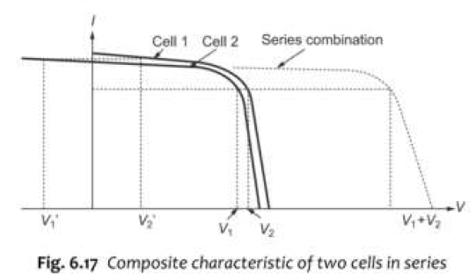
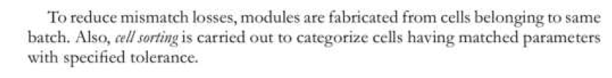
Problems to be taken care off:
Cell mismatch in the module:
All the cells used must have same specification, i.e. Voc, Isc, Vmpp, Impp. Else there will be power loss which will occur .

Slide 32
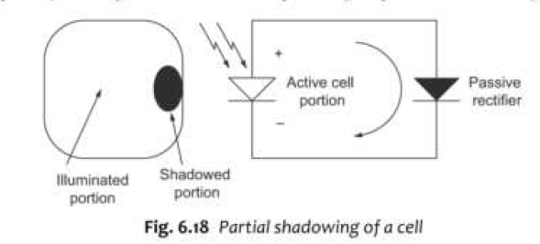
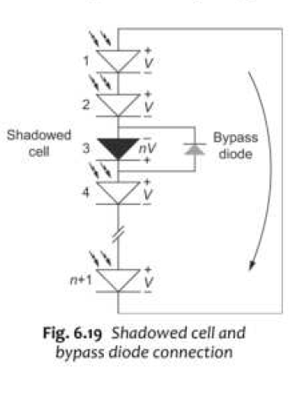
Effect of Shadow:
Shadowing on the perticular cells will stop the generation in those cells keeping the other cells active, if the active cells are more then the excessive current generated will damage the shadowed cell and this effect is called hot spot.
Solution for hot spot

Slide 33
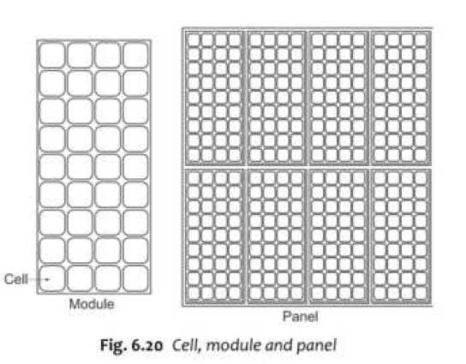
Solar PV Panel:
Multiple solar modules connected in series / parallel combination to extract large voltage and current and thus increase the output power.

Slide 34
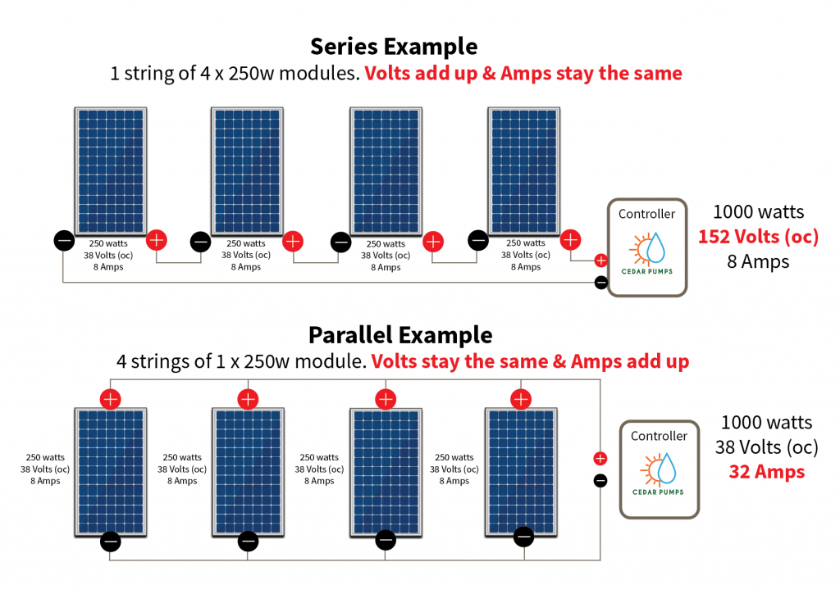
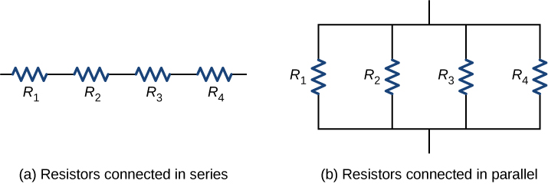
Modules connected in series:
Voltage gets added and current remains same.
Power= Voltage * Current

Slide 35
Modules connected in series:
Voltage remains same where as current gets added.

Slide 36
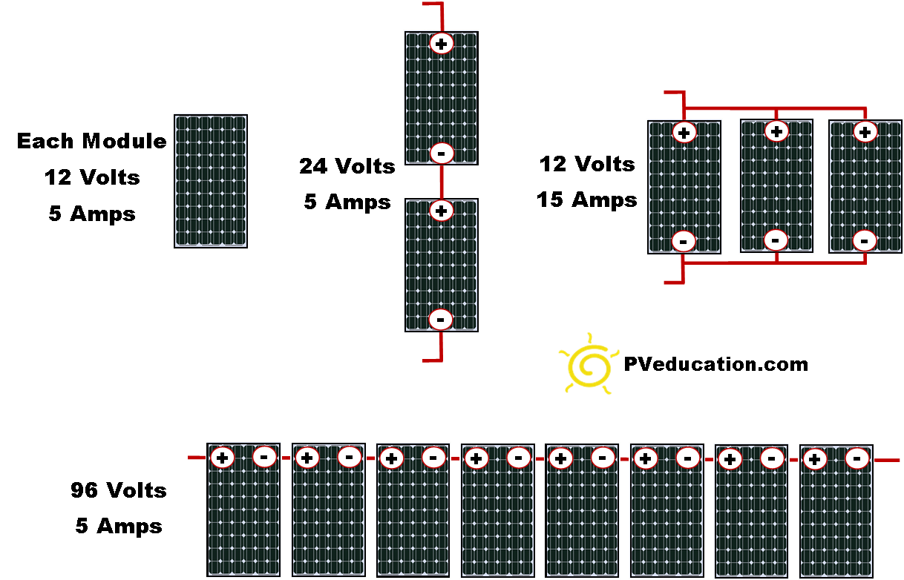

Slide 37
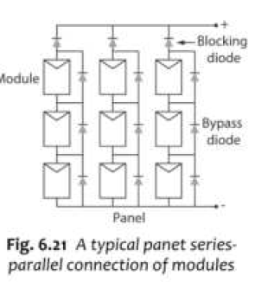
Blocking diode blocks the flowing of power in that string incase any fault occurs in a particular module.
Bypass diode will bypass the panel incase any fault ocures in that panel.

Slide 38
Solar PV Array:
Interconnection of multiple solar panels is called solar Array.
These arrays are mounted on a structure with an appropriate tilt angle with or without tracking system such that its shadow does not falls on other panels during any time of a days throughout the year.

Slide 39
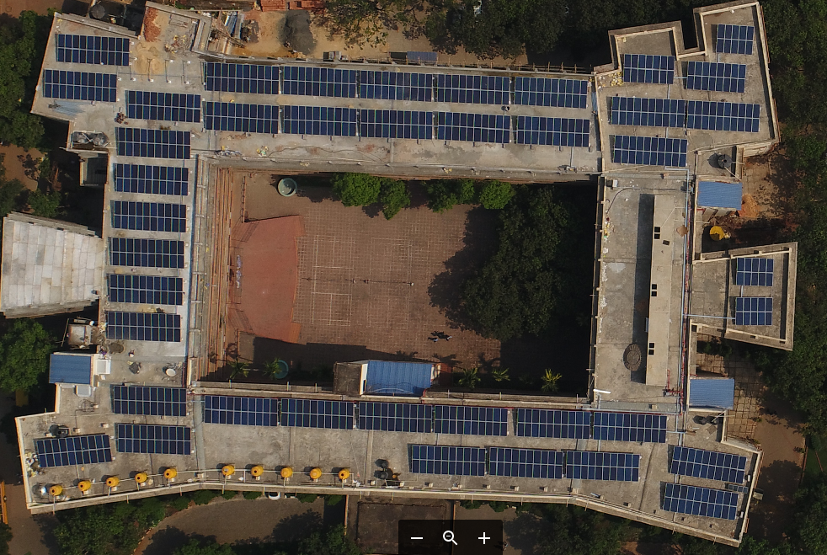

Slide 40
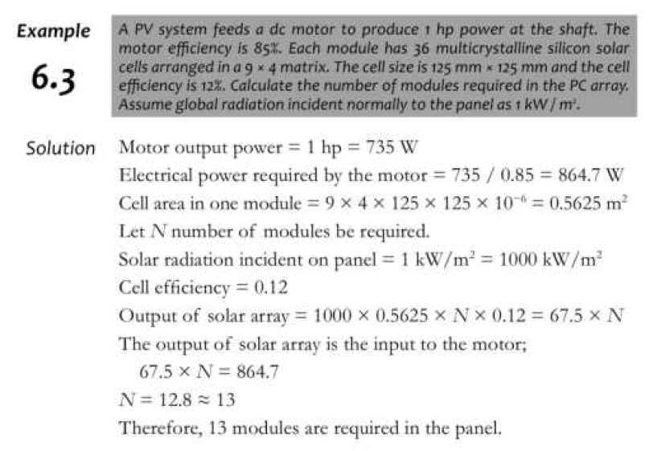

Slide 41
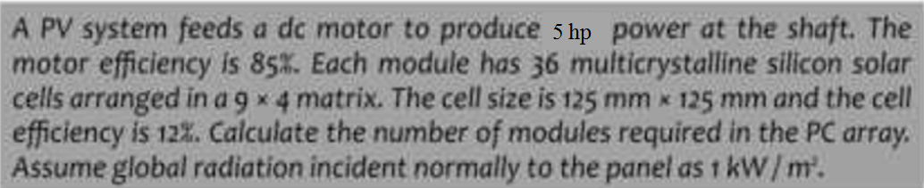
DC Motor

Slide 42
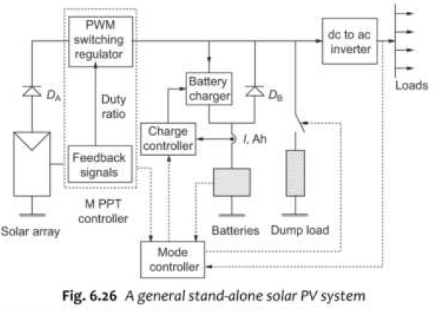
Stand-alone and grid connected
Stand-alone Solar PV System:
DA=Battery Discharge Diode avoids the battery to get overcharged.
DB =Array diode prevents the battery to discharge through PV array

Slide 43
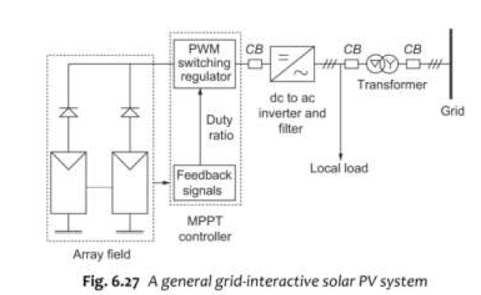
Grid connected Solar PV System

Slide 44
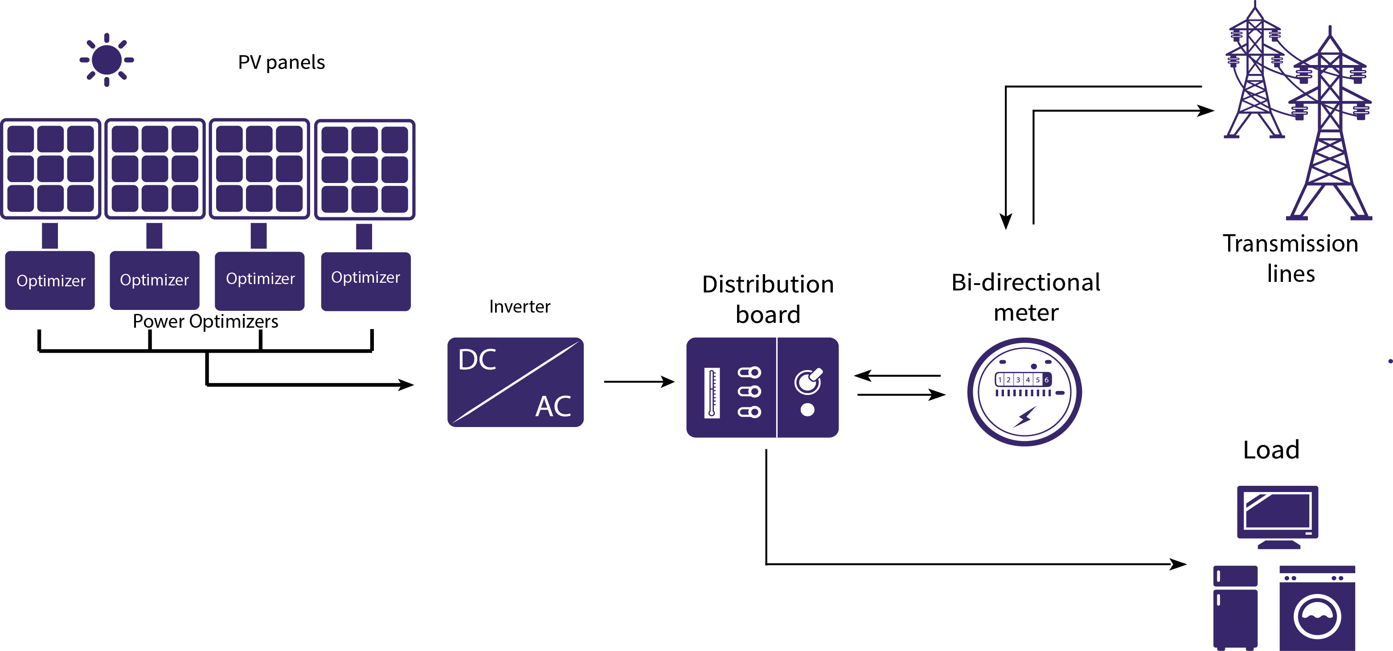
Connection Diagram as per HESCOM norms:

Slide 45
Applications –
Street lighting,
domestic lighting
solar water pumping systems.

Slide 46
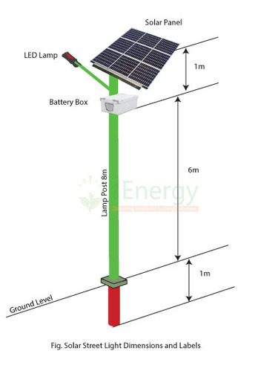
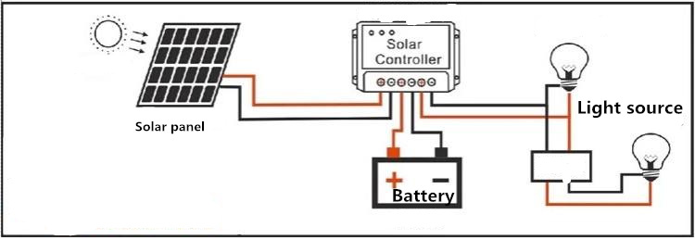
1. Solar PV Street lighting:
Variable DC voltage of solar panel is given to the charge controller, where it is converted into a fixed DC voltage and gives it to batteries.
The charge controller controllers the charging of the battery and disconnects it from the supply when it is fully charged and reconnects it charging lowers.
The battery discharges when the load is turned ON.

Slide 47
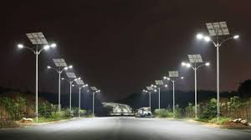
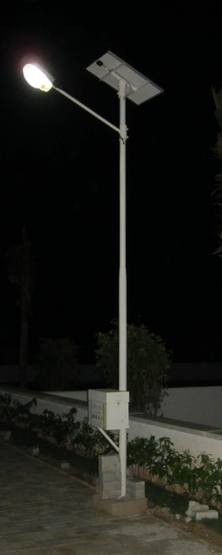
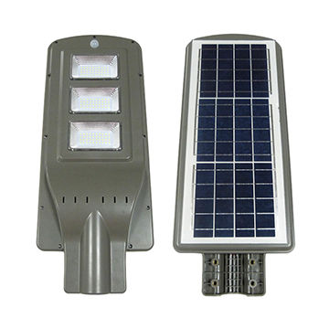

Slide 48
Street Light Design calculation:
Assume, LED Street light capacity: 36 W
Energy consumed per day:
Let the street light is on for 11 hrs per day ( 7pm to 6 am)
Energy consumed= power * Time = 36*11= 396 Wh/day
Charge controller capacity= 36W/ 12V = 3Amps.
Thus a charge controller of 3 amp rating can be used.
Battery calculation:
Let the battery used be of 12V.
Ampere hour required= 396 Wh per day / 12V =33 Amp-Hour
But the depth of Discharge of a battery is 70%.
So, 33*1.3= 42.9 Ah battery is required.
PV Panel sizing:
On an average 1kW PV panel can generate 4 kWh per day
PV panel capacity=396/4 =99.9 W=100W.

Slide 49

2. domestic lighting

Slide 50


3. Solar water pumping system:

Slide 51


Fig: Block diagram of solar water pumping system

Slide 52


Other applications: (Not in syllabus)
solar refrigerator

Slide 53

Solar Ship:

Slide 54


Solar Car:

Slide 55

Solar parking:

Slide 56

Floating Solar:

Slide 57

Thank You

